Slide 1
Building Networks
MA 653: Network Science
Instructor: Ashok Singh Sairam
ashok@iitg.ac.in

Slide 2
Types of network
Technological networks
The Internet, Telephone network, power grids, transportation network, delivery and distribution network, …
Information network
The WWW, citation network, other information network
Social networks
Biological networks

Slide 3
Social Networks

Slide 4
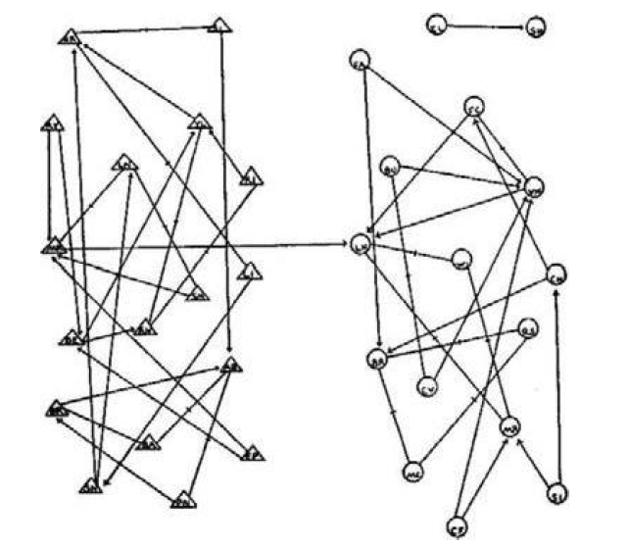
Empirical study of social networks
Social networks does not only refer to online social media but has a broader meaning
Network where nodes represent people and edges represent connections
Figure shows friendship pattern b/w
boys (triangles) and girls (circles) in a class
Drawn by Jacob Moreno in the 1930’s

Slide 5
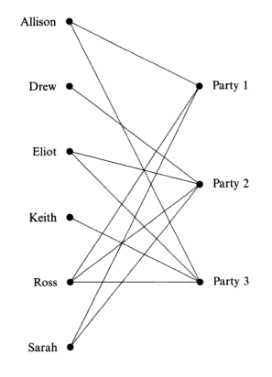
Affiliation Networks
Two types of entities - actors and societies (events)
Events can be a wide range of social occasions
Social clubs in a community
University committees
Boards of directors of major corporations
Related by affiliation of the actor to societies
Relationships form bipartite graphs, called affiliation networks;
They are two mode networks that allow to study the dual perspectives of the actors and the events
aka affiliation network

Slide 6
Ways to build Social networks
Interviews and questionnaires
Direct observation
Using data from archival or third party records
Sampling
Snowball sampling
Contact tracing
Random walk sampling

Slide 7
Accumulating data on social networks
Interviews and questionnaires
Pose questions and records answers in a uniform fashion
Who among your colleagues do you turn to most often for advice?
With whom do you most often discuss your cases in the course of an ordinary week?
Disadvantage
Tedious and inaccurate
Answers can be subjective
Inconsistencies
Sociometric study, almost all individuals in a community are surveyed
May not be possible for large population size

Slide 8
Direct observation
Watch interactions b/w individuals over a period of time on the population of interest
Example: Karate club
Again labor intensive, thus restricted to small groups
The only viable option to study the social network of animals
Not all animal species form interesting social networks
Dominance hierarchies – aggressive behaviour resulting in one animal establishing dominance over other

Slide 9
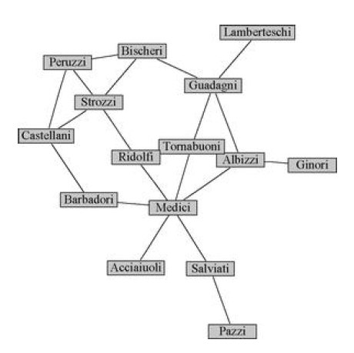
Using data from archival or third party records
Email network from email logs
Telephone call graph
Mobile phone network
Date and time are also recorded, true for email networks also
Does not only reveal the call record but also the location
OSN as part of their operation record connections, hence a rich source of archival network data
Most archives are proprietary
Intermarriage network

Slide 10
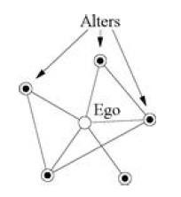
Ego-centered networks (part of Interviews & Questionnaire)
Ego-centered networks are networks surrounding one individual
The individual surveyed is referred to as the ego and the contacts as alters
Select a sample of the entire population and use direct questioning techniques
Less tedious but cannot reveal the structure of the entire network

Slide 11
Snowball sampling
Study of drug users or illegal migrants present simple problem as they are wary of giving interviews
Snowball sampling is a non-probability sampling technique to identify potential subject that are hard to locate
Start with an initial member and interview them
Upon gaining confidence of the member, extract the name of other members
Continue the process, soon the process “snowballs” to a large sample
Snowball sampling gives largely biased samples

Slide 12
Contact tracing
Similar to snowball tracing
Process of identifying, accessing and managing people (contacts) that are exposed to a disease
For example contact tracing of Covid-19
Person tests positive
Identify contacts who have been exposed to the patient in the last 14 days
While the purpose of contact tracing is to break the chain of a disease, in the process data about network is achieved
Data can be biased as similar to contact tracing

Slide 13
Random-walk sampling
Similar to snowball tracing, start with a single member of the target population and determine all its contacts
However, instead of tracking all the contacts, choose one of them at random
If the person cannot be found choose another
Repeat the process
Chances of sampling bias is relatively less since subjects are chosen at random

Slide 14
Milgrams small world experiment (1967) - 1
Milgram was interested in quantifying the typical distance between actors in social networks.
Chose a target person (friend in Boston, Massachusetts)
Asked randomly chosen “starters” to forward a letter to the target
Name, address, and some personal information were provided for the target person
The participants could only forward a letter to a single person that he/she knew on a first name basis
Record the path taken by the letter
Goal: To advance the letter to the target as quickly as possible

Slide 15
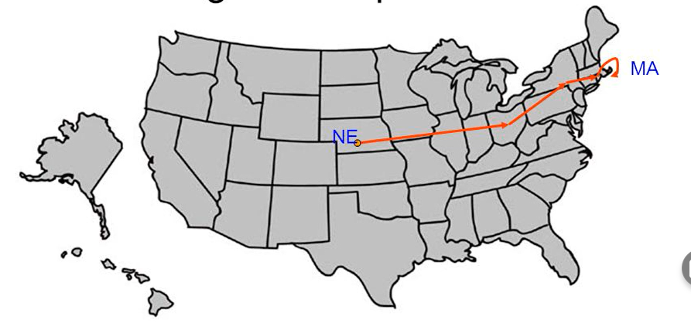
Milgrams small world experiment (1967) - 2
Outcome revealed two fundamental components of a social network:
Very short paths between arbitrary pairs of nodes
Individuals operating with purely local information are very adept at finding these paths

Slide 16
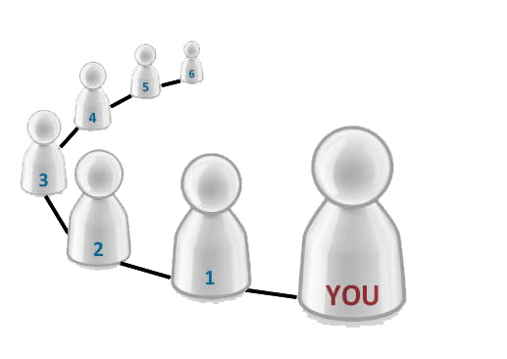
What is the “small world” phenomenon?
Principle that most people in a society are linked by short chains of acquaintances
Sometimes referred to as the “six degrees of separation” theory

Slide 17
Biological Networks

Slide 18
Biological network model
Node
Protein, peptide, or non-protein biomolecules.
Edges
Biological relationships, etc., interactions, regulations, reactions, transformations, activation, inhibitions.

Slide 19
Biological Network Model
It is usually represented by a 2-D diagram with characteristic symbols linking the protein and non-protein entities.
A circle indicates a protein or a non-protein biomolecule.
A symbol in between indicates the nature of molecule-molecule process (activation, inhibition, association, disassociation, etc.)

Slide 20
BIOLOGICAL NETWORK
Networks are found in biological systems of varying scales:
The metabolic network in cells
The protein interaction network in cells
Networks in the brain
Ecological networks
Expression networks
Regulatory networks
Genetic control networks of organisms
Evolutionary tree of life
… more biological networks

Slide 21
Metabolic networks
Metabolism: chemical process by which cells break down food
During the process, chemicals are produced known as metabolites
Example: carbohydrates, lipids, amino acids
Chemicals produced are consumed by reactions
Nodes: ?? (Ans in next slides)
(The vertices in a metabolic network are the chemicals produced and consumed by the reactions. These chemicals are known generically as metabolites. By convention the definition of a metabolite is limited to small molecules, meaning things like carbohydrates (such as sugars) and lipids (such as fats), as well as amino acids and nucleotides)
Edges: ?? (Ans in next slides)

Slide 22
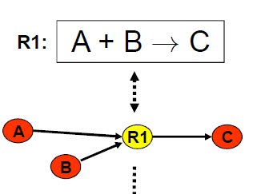
Ex: Metabolic networks
What type of network?
Ans: Bipartite Network

Slide 23
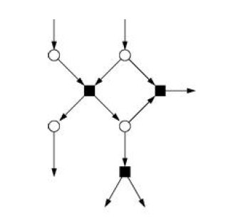
Metabolic networks: bipartite graph
Two types of nodes: metabolites (circles) and reactions (squares)
Edges which metabolites are input to a reaction and output of the reaction
Bipartite graph
Eg: A + B → C

Slide 24
Metabolic networks
Metabolism: chemical process by which cells break down food
During the process, chemicals are produced known as metabolites
Example: carbohydrates, lipids, amino acids
Chemicals produced are consumed by reactions
Nodes: metabolites and reactions
Edges: Interactions
Almost all reactions are catalysed by enzymes

Slide 25
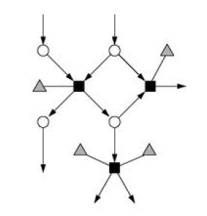
Metabolic networks: tripartite graph
Incorporate the enzymes by introducing a third class of nodes
Metabolic networks can be used to detect comorbidity patterns in diseased patients
obesity and diabetes
Metabolic disease networks can be used to determine if two disorders are connected due to their correlated reactions

Slide 26
Proteins in a cell
There are thousands of different active proteins in a cell acting as:
enzymes, catalysors to chemical reactions of the metabolism
components of cellular machinery (e.g. ribosomes)
regulators of gene expression
Certain proteins play specific roles in special cellular compartments.
Others move from one compartment to another as “signals”.

Slide 27
Protein Interactions
Proteins perform a function as a complex rather as a single protein.
Knowing whether two proteins interact can help us discover unknown proteins’ functions:
If the function of one protein is known, the function of its binding partners are likely to be related- “guilt by association”.
Thus, having a good method for detecting interactions can allow us to use a small number of proteins with known function to characterize new proteins.
Nodes: ?? and Edges: ??
Ans: The set of all protein-protein interactions forms a protein-protein interaction network, in which the vertices are proteins and two vertices are connected by an undirected edge if the corresponding proteins interact.

Slide 28
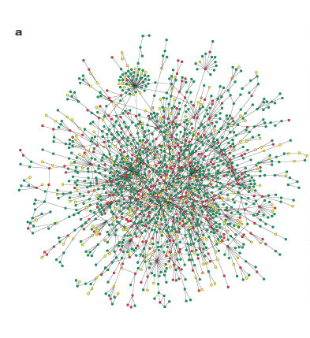
Yeast Protein Interaction Network
Nodes: Protein
Edges: Undirected edge, if the proteins interact
The yeast protein interaction network seems to reveal some basic graph theoretic properties:
The frequency of proteins having interactions with exactly k other proteins follows a power law.
The network exhibits the small world phenomena: can reach any node within small number of hops, usually 4 or 5 hops
Robustness: Resilient and have strong resistance to failure on random attacks and vulnerable to targeted attacks.

Slide 29
Genes
Proteins are biological polymers
long-chain molecules formed by concatenation of amino acids
Amino acids are manufactured by metabolic process but their assembly into complete proteins is achieved by machinery of genetics
the sequence recipe is stored in the cells genetic material called DNA
the DNA code for single protein is called gene
RNA converts the genetic information contained within DNA to a format used to build proteins, and then moves it to ribosomal protein factories
Messenger RNA (mRNA) copies portions of genetic code, a process called transcription, and transports these copies to ribosomes, which are the cellular factories that facilitate the production of proteins from this code.

Slide 30
Regulatory Network
Proteins encoded in a given gene can act as a transcription factor promoting or inhibiting the production of one or more proteins, which themselves can act as one or more proteins
The complete set of such interactions form a regulatory network
Node: Protein/gene that encode the protein
Directed edge: from gene A to B, indicates A regulates the expression of B

Slide 31
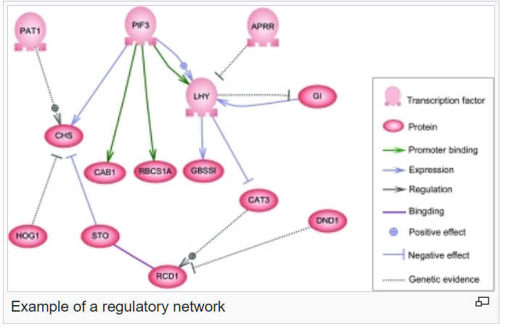
Notes:
.

Slide 32
Networks in the brain
Another use case of networks is study how brains/central nervous systems work
Our brains are a huge network of processing elements
Massive parallel processing system
The primary processing element is the neuron
combines several inputs to produce a single output
A typical brain contains a network of 10 billion neurons.

Slide 33
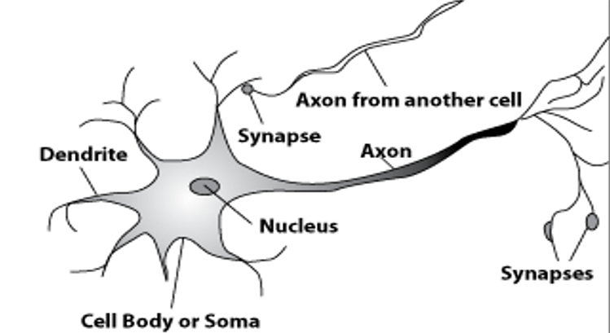
How are neurons wired?
A processing element (neuron)
Dendrite: Input
Receives input from other neurons
Input exceeds a threshold, discharges a spike that travels to next neuron(s) through axon
Cell body: Processor
Synapse: Link
Connect to other neurons ~10000 synapses
Axon: Output
Almost touches the dendrites of next neuron
Transmission of an electrical signal from one neuron to the next is effected by neurotransmitters.

Slide 34
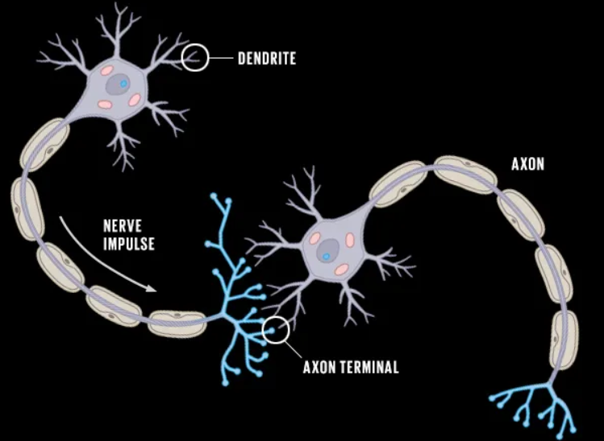
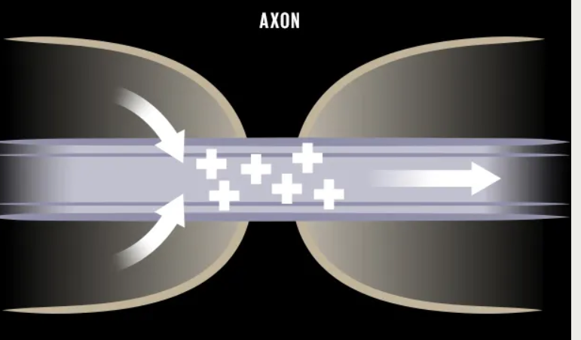
Neurons in action
Open channels allow ions to flow in, creating a propagating signal

Slide 35
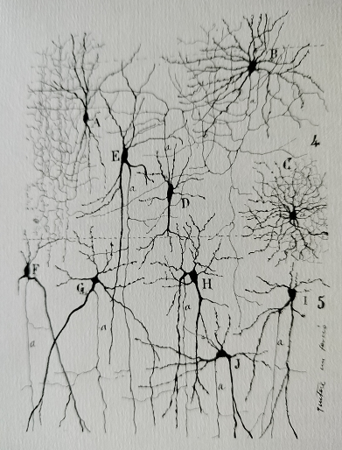
Hand-drawn illustration of brain cells
Created by staining slices of brain cells
Staining is crucial to make the brain cells visible at optical wavelengths
Challenge is the density of neurons that are tightly packed
Clear need for new methods to study the brain
Modern theories of networks are valuable methods to study such complex networks

Slide 36
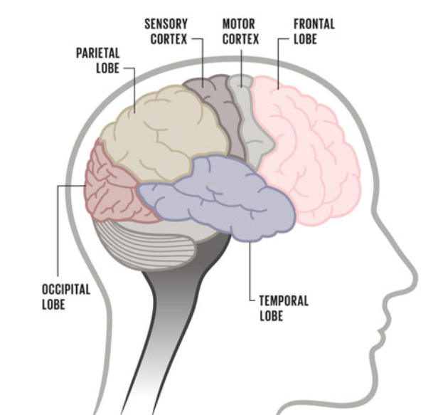
Functional brain networks
Network of macroscopic functions
Parietal lobe: integrating sensory input
Temporal lobe: process sensory input
Occipital lobe: vision
Frontal lobe: voluntary movement
Sensory cortex: processing somatic sensations
Motor cortex: body movement
Nodes: entire brain region
Edges functional connection
Can shed light on how different processes are interlinked

